Slide 1
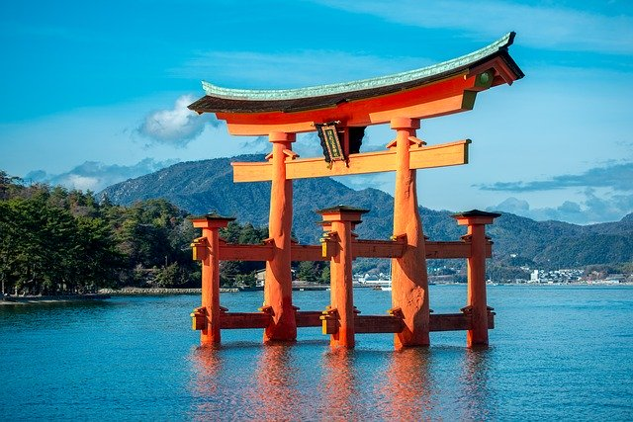
Review of Hiroshima Trip
Hiroshima is a must go. There are a mix of historical and modern sites that are worth exploring. The torii gate in the ocean is a good example of some amazing history. Such structure standing for centuries shows the amount of detail they put into the construction.
Baseball also seems to be a popular thing right now. I see many people in their favorite team jersey.

